Slide 1

Theoretical Project: Apache Sedona
Advanced Data Management
Ruben Rodrigues

Slide 2
What is Apache Sedona?
Apache Sedona is a cluster computing system designed for processing large-scale spatial data.
It extends existing cluster computing systems like Apache Spark, Apache Flink, and Snowflake with distributed spatial datasets and Spatial SQL capabilities.
The primary objective of Apache Sedona is to provide a scalable and efficient framework for processing huge amounts of spatial data within the Apache Spark ecosystem.

Slide 3
Feartures
Provides out-of-the-box distributed Spatial Datasets and Spatial SQL for efficient loading, processing, and analysis of large-scale spatial data across machines.
Enables complex geospatial analytics, spatial queries, and visualization activities on large datasets.
Offers APIs in Scala, Java, Spatial SQL, Python, and R, making it accessible to a wide range of developers.
Integrates into existing Spark workflows and allows applications to be run in any cloud environment.
Facilitates the construction of geospatial applications in various fields such as urban planning, transportation, environmental monitoring, and location services.

Slide 4
Advantages
High Speed
Low Memory Consuption
Ease of Use
Integration
Scalability
Price

Slide 5
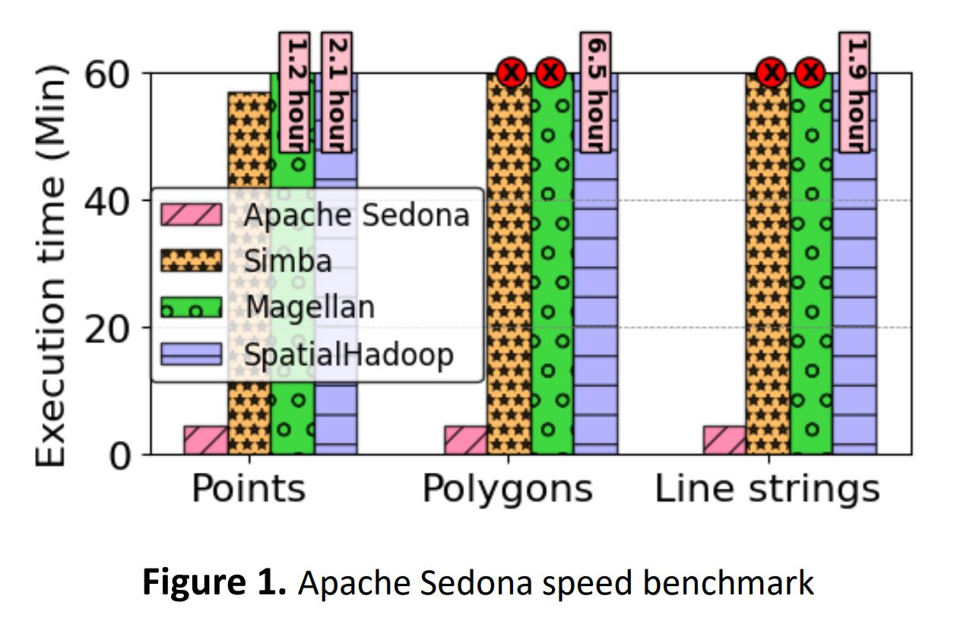
Advantages

Slide 6
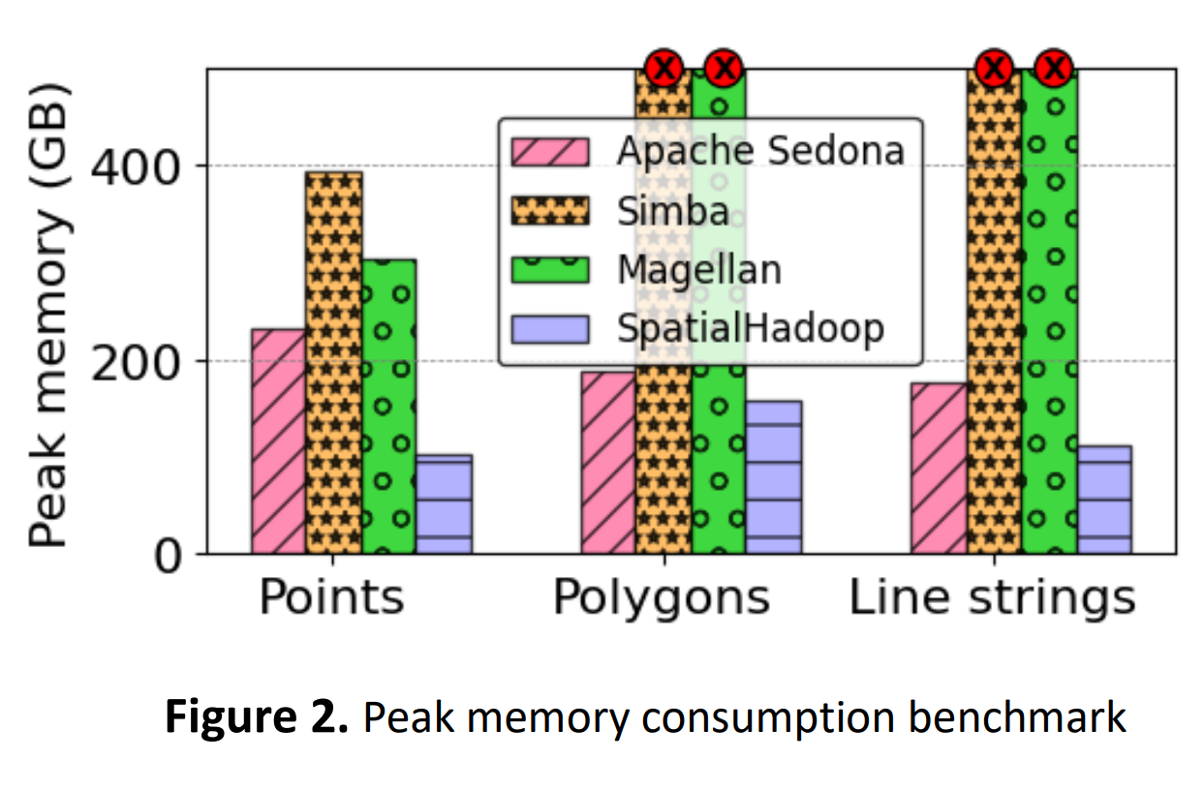
Advantages

Slide 7
Use Cases
Urban Planning and Development
Transportation and Logistics Optimization
Environmental Monitoring and Conservation
Location-Based Services and Geospatial Intelligence
Agricultural Monitoring and Precision Farming
Emergency Response and Disaster Management

Slide 8
Types of Data
Apache Sedona supports a range of spatial data formats, including:
Shapefile
GeoJSON
Well-Known Text (WKT)
Well-Known Binary (WKB)
PostGIS Spatial Parquet
This flexibility enables users to seamlessly load spatial data from different sources and formats into their processing pipelines.

Slide 9
Common Types of Spatial Data
Point Data: Represents individual geographic points defined by their coordinates (latitude and longitude). Examples include locations of landmarks, addresses, or GPS coordinates of vehicles. Line Data: Consists of linear features defined by sequences of connected points. Examples include roads, rivers, pipelines, or flight paths.
Polygon Data: Represents closed geometric shapes with multiple interconnected points, enclosing an area. Examples include administrative boundaries, land parcels, or building footprints.
Multi-Point Data: Comprises collections of individual points grouped together. Represents sets of spatially related points. Examples include clusters of GPS coordinates or sensor measurements. Multi-
Line Data: Consists of collections of linear features grouped together. Represents sets of spatially related linear features. Examples include transportation networks or utility lines.
Multi-Polygon Data: Comprises collections of polygons grouped together. Represents sets of spatially related areas. Examples include complex administrative boundaries or geological formations.

Slide 10
Requirements for installation and hardware
The hardware requirements for Apache Sedona depend on the scale of your spatial data processing tasks and the size of your datasets.
Generally, Apache Sedona can run on standard hardware configurations commonly used for Apache Spark deployments.

Slide 11
Requirements for installation and hardware
CPU: Multiple CPU cores are beneficial for parallel processing, similar to Apache Spark. Recommended to have multi-core CPUs to leverage parallelism, especially for processing large datasets.
RAM Memory: RAM requirements depend on dataset size and spatial operation complexity. More RAM generally leads to better performance, especially for in-memory processing of large datasets.
Storage: No specific storage requirements beyond those of Apache Spark. Adequate storage space needed for storing spatial datasets and intermediate data.
Operating System: Compatible with Linux, macOS, and Windows.

Slide 12
Potential Costs Attached
Apache Sedona is an open-source project released under the Apache License 2.0, which means it is free to use, modify, and distribute without any licensing costs.
As an open-source project, Apache Sedona is freely available for both commercial and non-commercial use, and there are no direct costs associated with acquiring or using the software.

Slide 13
Guidelines for Installation
Install Jupyter Notebook or Jupyter Lab:
Ensure you have Jupyter Notebook or Jupyter Lab installed on your system. These interactive computing environments for Python allow you to create and share documents containing live code, equations, visualizations, and narrative text.

Slide 14
Guidelines for Installation
Preferably Install Docker:
Docker is a containerization platform that simplifies the deployment and management of applications by packaging them into standardized units called containers.
Installing Docker is preferred for running Apache Sedona in a containerized environment, providing ease of setup and portability across different systems.
Docker containers ensure consistency in the runtime environment, making it easier to reproduce the Apache Sedona environment across different systems without worrying about software dependencies and configuration issues.

Slide 15
Guidelines for Installation
docker pull apache/sedona:latest
docker pull apache/sedona:latest
Search for Apache Sedona Image on Docker Hub:
After installing Docker, navigate to Docker Hub and search for the Apache Sedona image.
You can find the image by searching for "apache/sedona:latest" or "apache/sedona:1.5.1".
Pull and Run the Apache Sedona Container:
Once you've found the Apache Sedona image, pull it using the following command:
“docker pull apache/sedona:latest”

Slide 16
Guidelines for Installation
After pulling the image, run the container using the following command:
“docker run -p 8888:8888 -p 8080:8080 -p 8081:8081 -p 4040:4040 apache/sedona:latest”
This command will start the Apache Sedona container and expose the necessary ports for accessing the Jupyter Lab interface.
Access Jupyter Lab:
After running the container, you’ll see a link to access Jupyter Lab in your terminal.
“http://127.0.0.1:8888/lab”
Open the provided link in your web browser to access the Jupyter Lab interface.

Slide 17
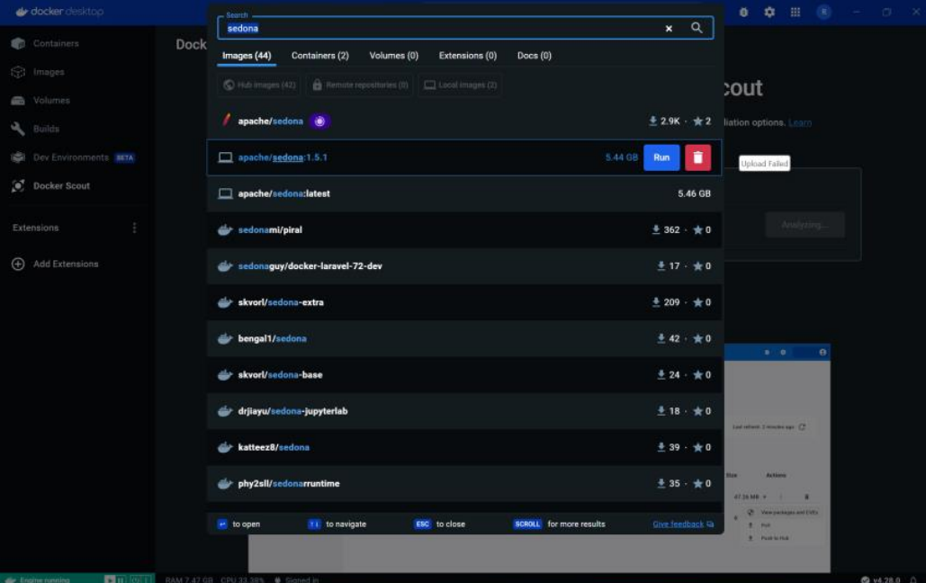
Examples

Slide 18
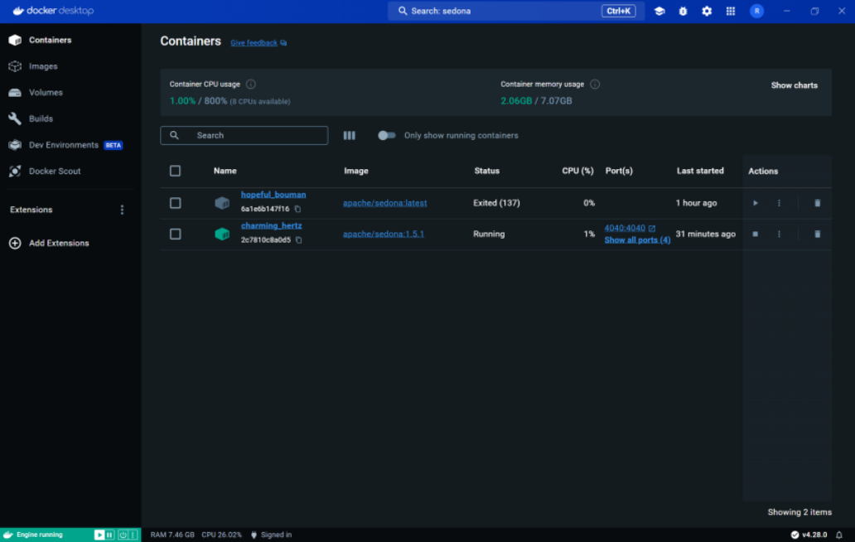
Examples

Slide 19
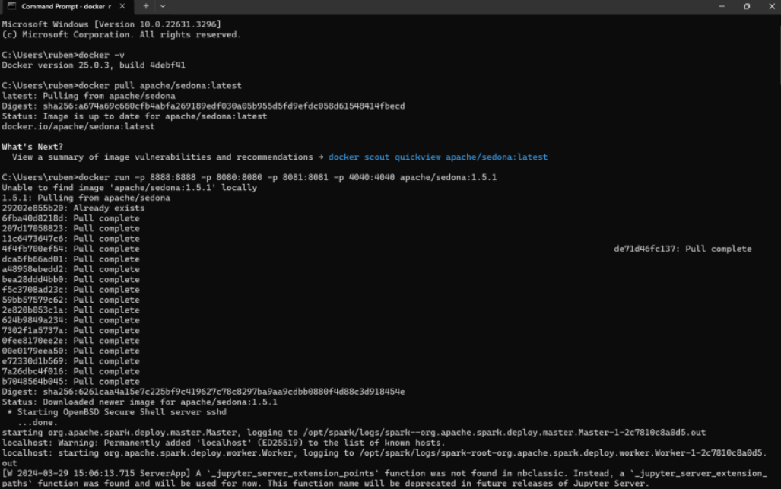
Examples

Slide 20
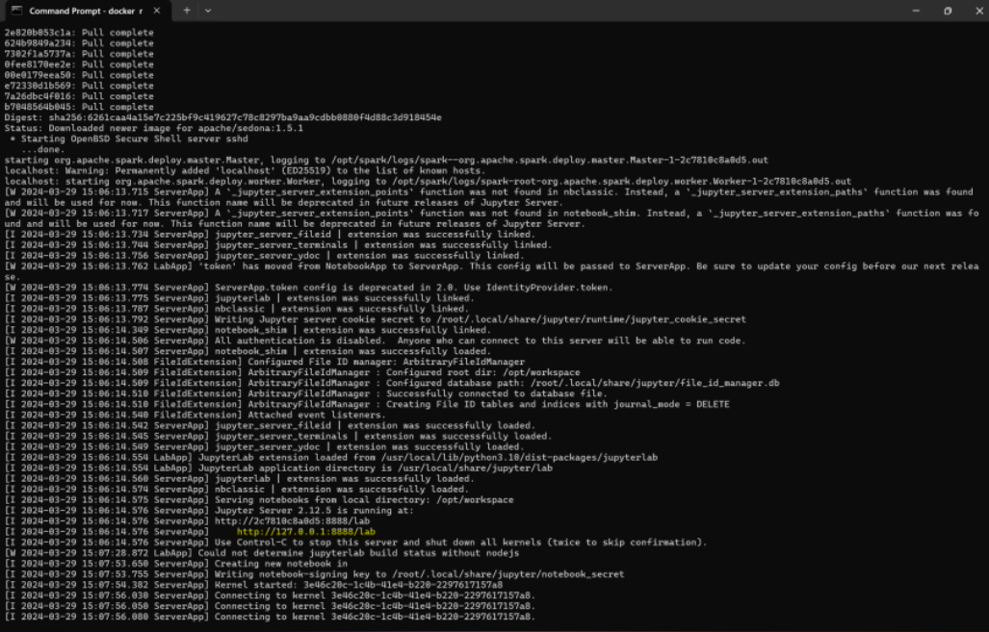
Examples

Slide 21
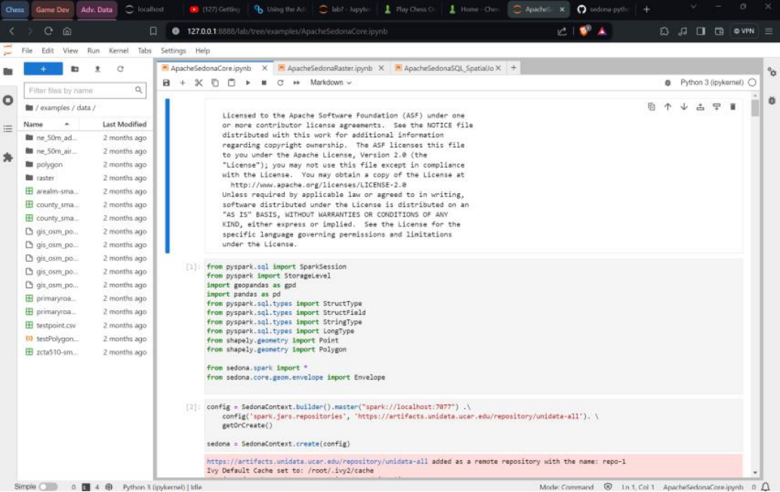
Examples

Slide 22
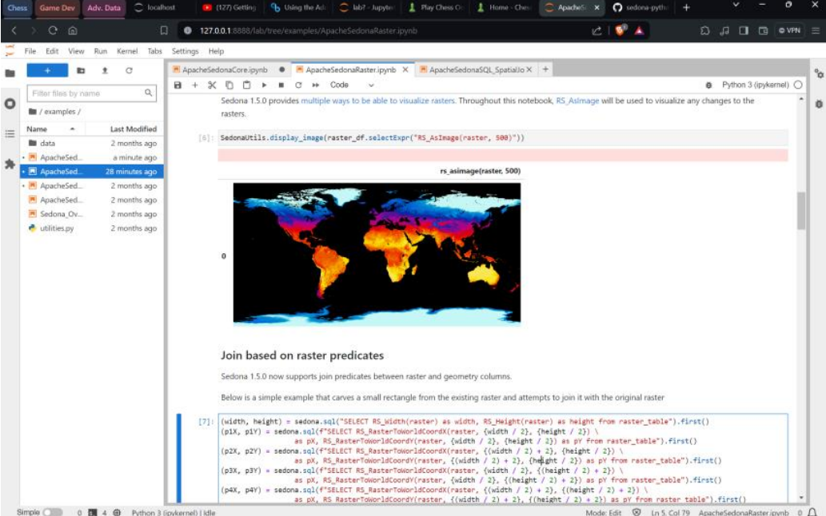
Examples

